Slide 1
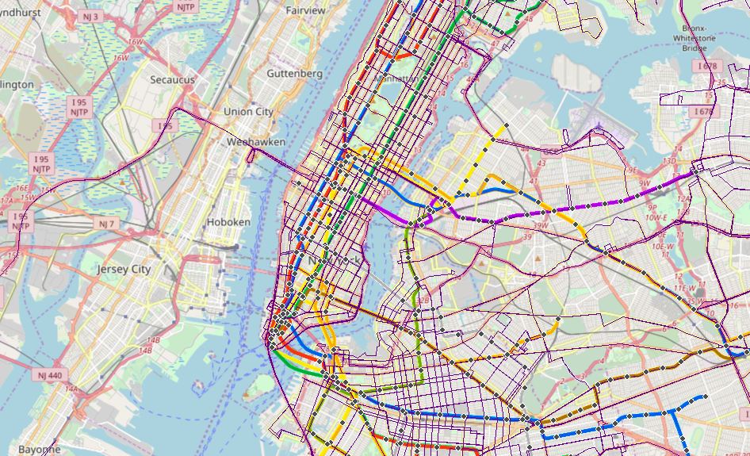
Project Benson
Curtis

Slide 2
Objective
Identify optimal subway station locations to place street teams in order to increase attendance and likelihood of donations to the WomenYesWomenTech (WYWT) annual gala.

Slide 3
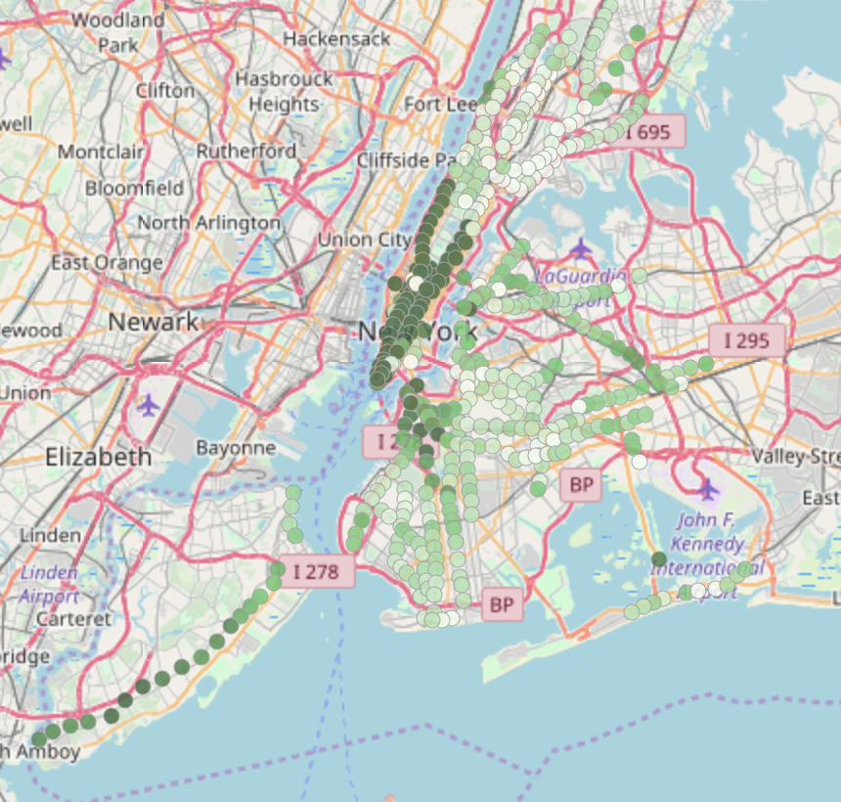
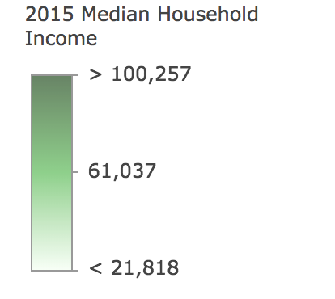
2015 Median Household Income
Esri, U.S. Census Bureau

Slide 4
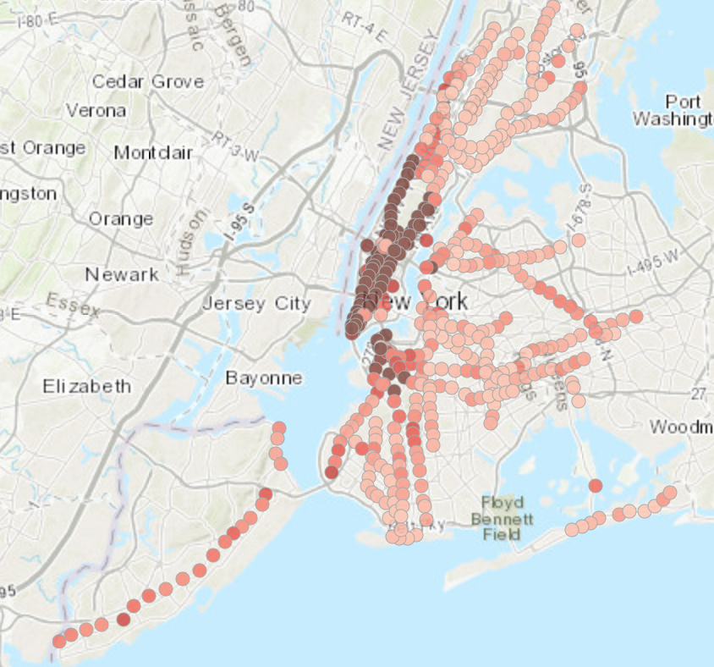
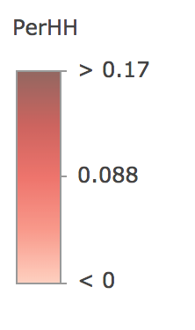
Total Households +200K Ages (25 - 64)
Esri, U.S. Census Bureau

Slide 5
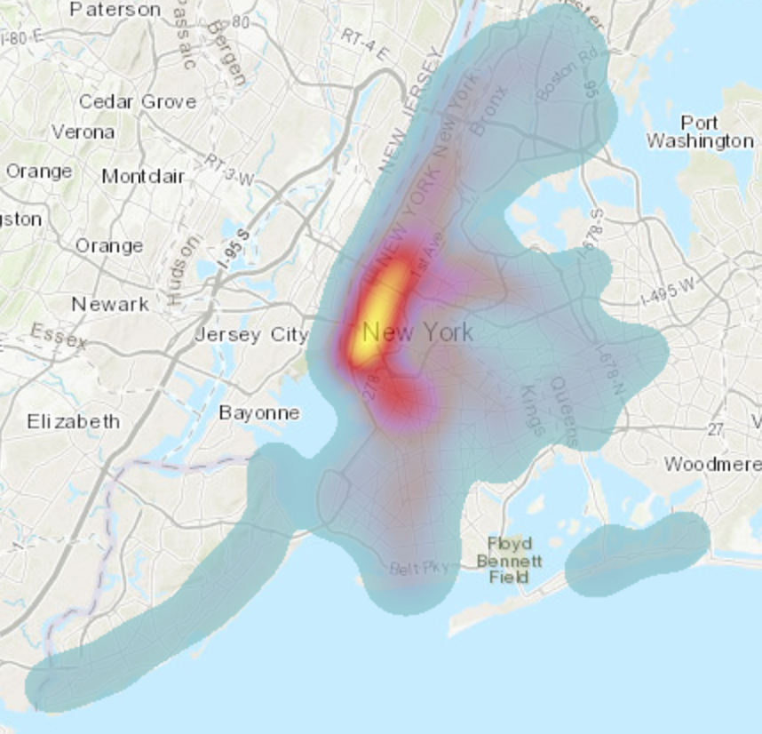
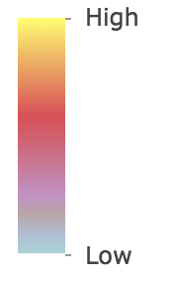
Bachelor Degree Attainment
Esri, U.S. Census Bureau

Slide 6
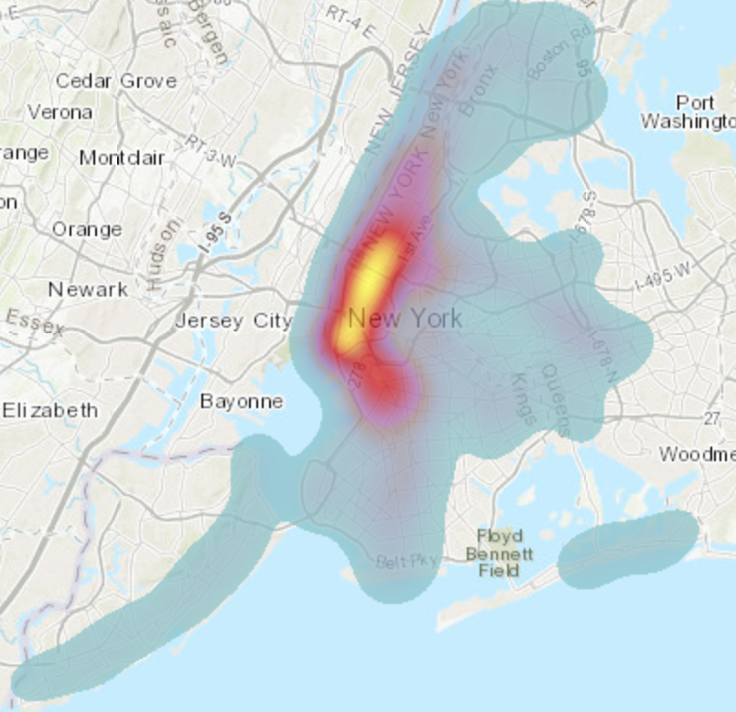
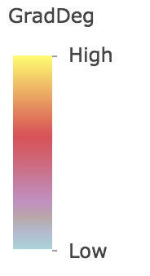
Graduate Degree Attainment

Slide 7
Metrics
Stations with the greatest foot traffic
Median Income
Ages 25 – 64, Households Total 200K+

